Slide 1

GUI AUTOMATION
PROFESORS:-
1)RESHMA VERMA
2)SHARMILA SUTTUR
TEAM MEMBERS:-
1)ASHISH GURRAM
2)ANURAG PALIWAL
3)SRISHTI AGRAWAL
4)KUMAR SATYAM

Slide 2
Work-let Name: GUI AUTOMATION
Worklet Details
Worklet ID: SQAE01MS
College Name: Ramaiah Institute Of Technology
-Able to extract text, dimensions , co-ordinates, background-colour of the element.
- We are not able to extract text information like font style and font size.
KPIs achieved till now
Any Challenges/ Issues faced
Next Steps
-to extract font style and size.
-to automate the whole process.
-Other than font style and size, we are able to extract all other information.
Key Achievements/ Outcome till now
Date: 21-12-2021

Slide 3
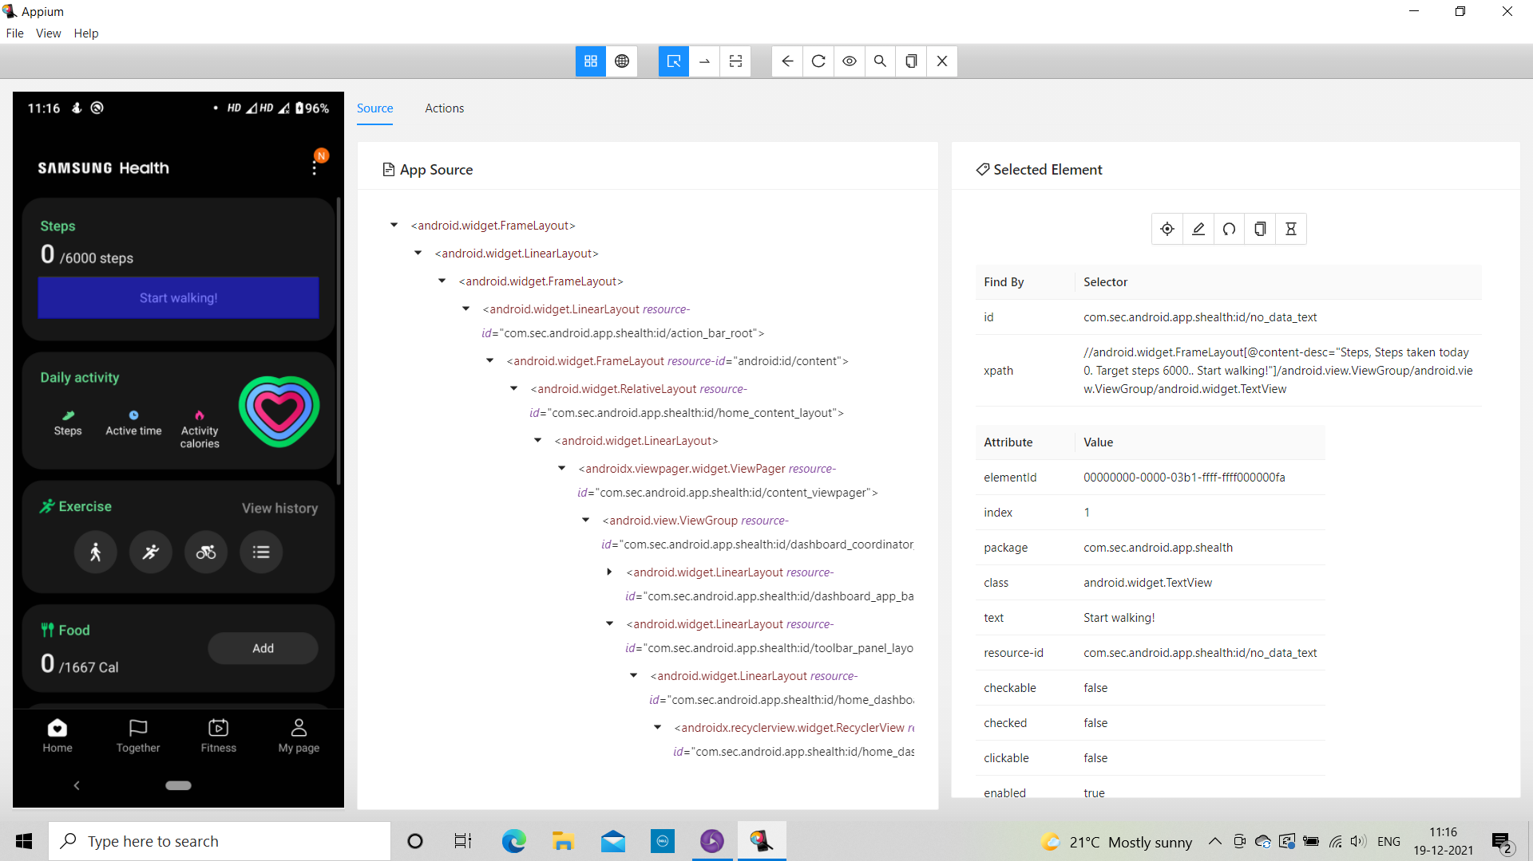

Slide 4
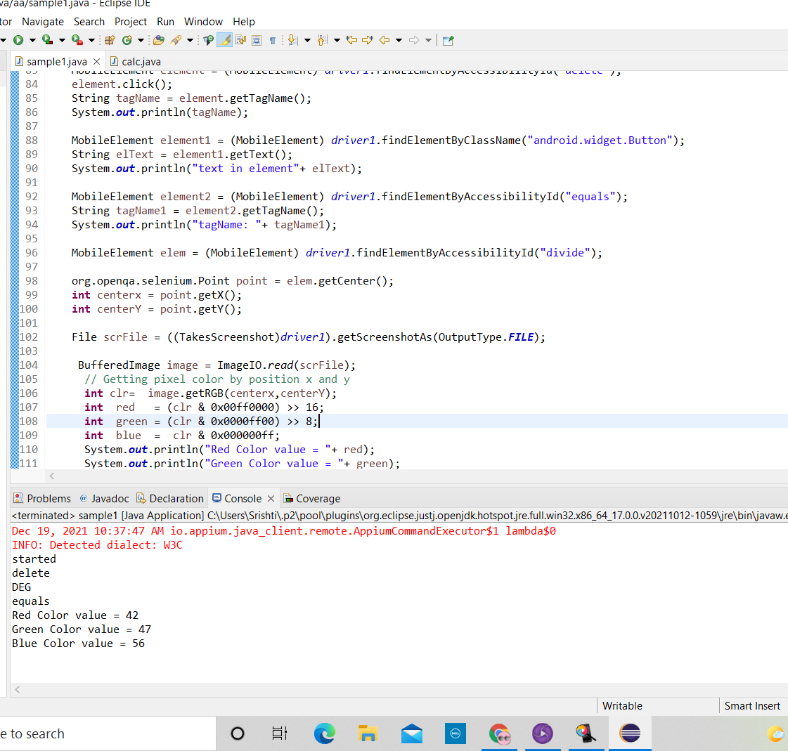
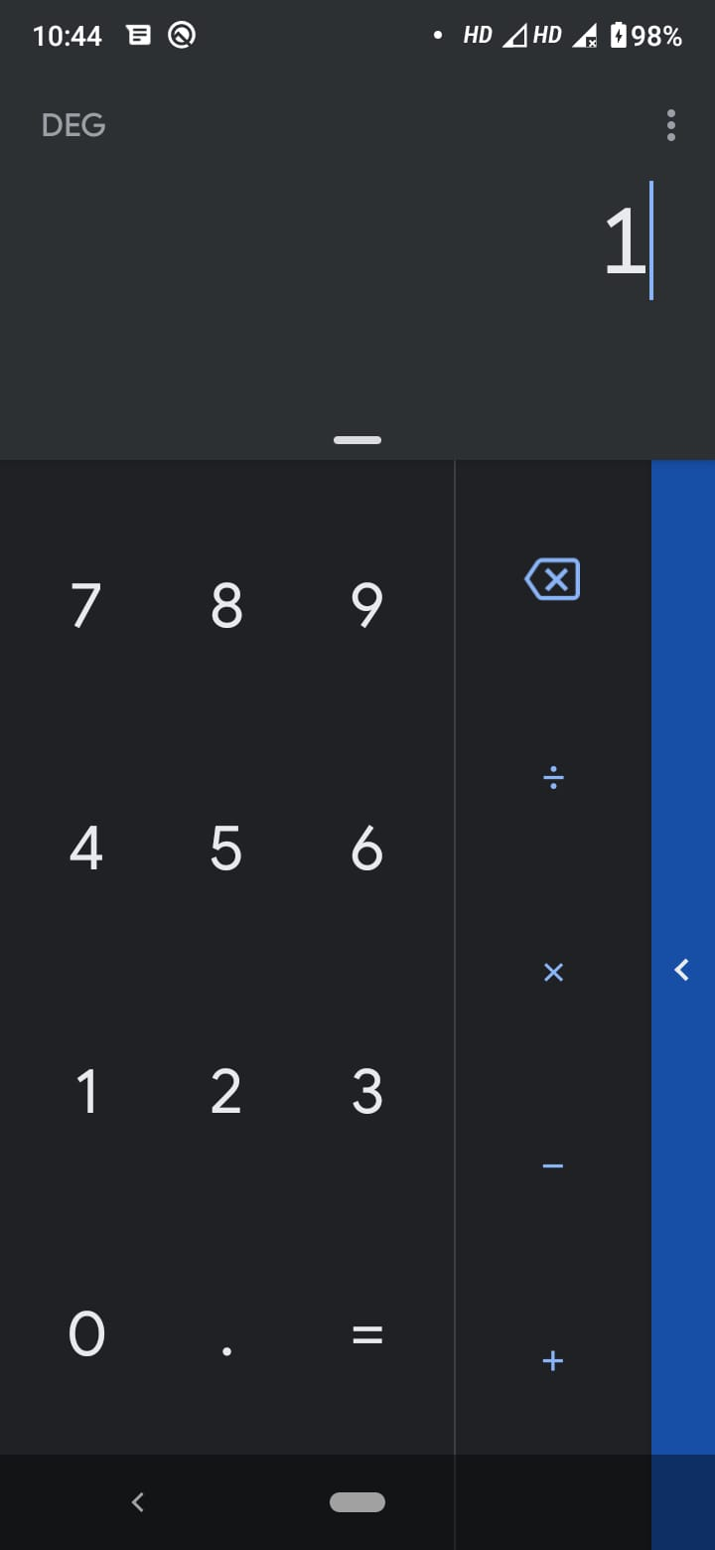

Slide 5
